Slide 1
CI/CD Workflow
Prepared By: Datalake Squad

Slide 2
Overview
Simple Architecture and Flow

Slide 3
CI/CD Environment Setup
Bamboo @Dev Server 1
(VIDDCLXDIFRDB01 /10.170.49.62)
Bitbucket @Dev Server 2
(VIDDCLXUIFRDB01 /10.170.49.63)
Dev Laptop (HTTP & GIT Client)

Slide 4
CI/CD Interactions
Git Trigger (auto)
Bamboo @Dev Server 1
(VIDDCLXDIFRDB01 /10.170.49.62)
Bitbucket @Dev Server 2
(VIDDCLXUIFRDB01 /10.170.49.63)
SSH Execute
(auto)
Git Push/Pull (SSH – Port 22)
Administration and Configguration (http – port 8085)
Administration and Configguration (http – port 7990)
Dev Laptop (HTTP & GIT Client)

Slide 5
CI/CD Interactions
Git Trigger (auto)
Bamboo @Dev Server 1
(VIDDCLXDIFRDB01 /10.170.49.62)
Bitbucket @Dev Server 2
(VIDDCLXUIFRDB01 /10.170.49.63)
SSH Execute
(auto)
SSH Execute (Task) => current
Build the artifactory and store
Administration and Configguration (http – port 8085)
Git Push/Pull (SSH – Port 22)
Administration and Configguration (http – port 7990)
Artifactory Repository Server
(Jfrog)
Dev Laptop (HTTP & GIT Client)
Get and run the artifact
Dev Server (executor)
GPDR and Database Server

Slide 6
CI/CD Interactions
Git Trigger (auto)
Bitbucket @Dev Server 2
(VIDDCLXUIFRDB01 /10.170.49.63)
SSH Execute
(auto)
Bamboo @Dev Server 1
(VIDDCLXDIFRDB01 /10.170.49.62)
Plan
Job
Bitbucket Repository
Tasks

Slide 7
Screenshots

Slide 8
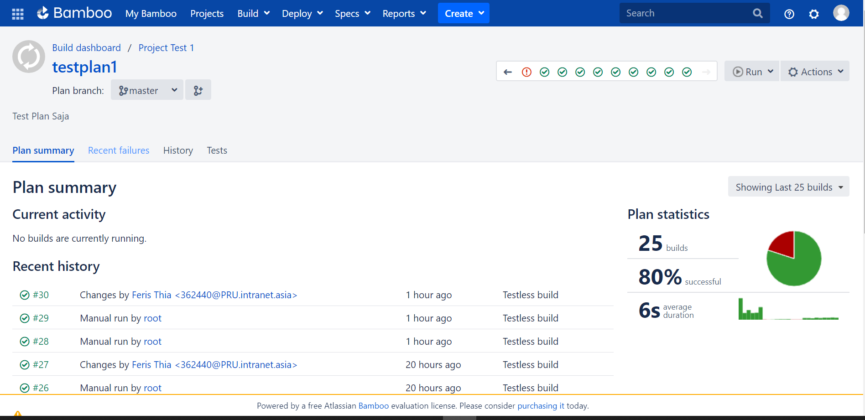
Bamboo Plan

Slide 9
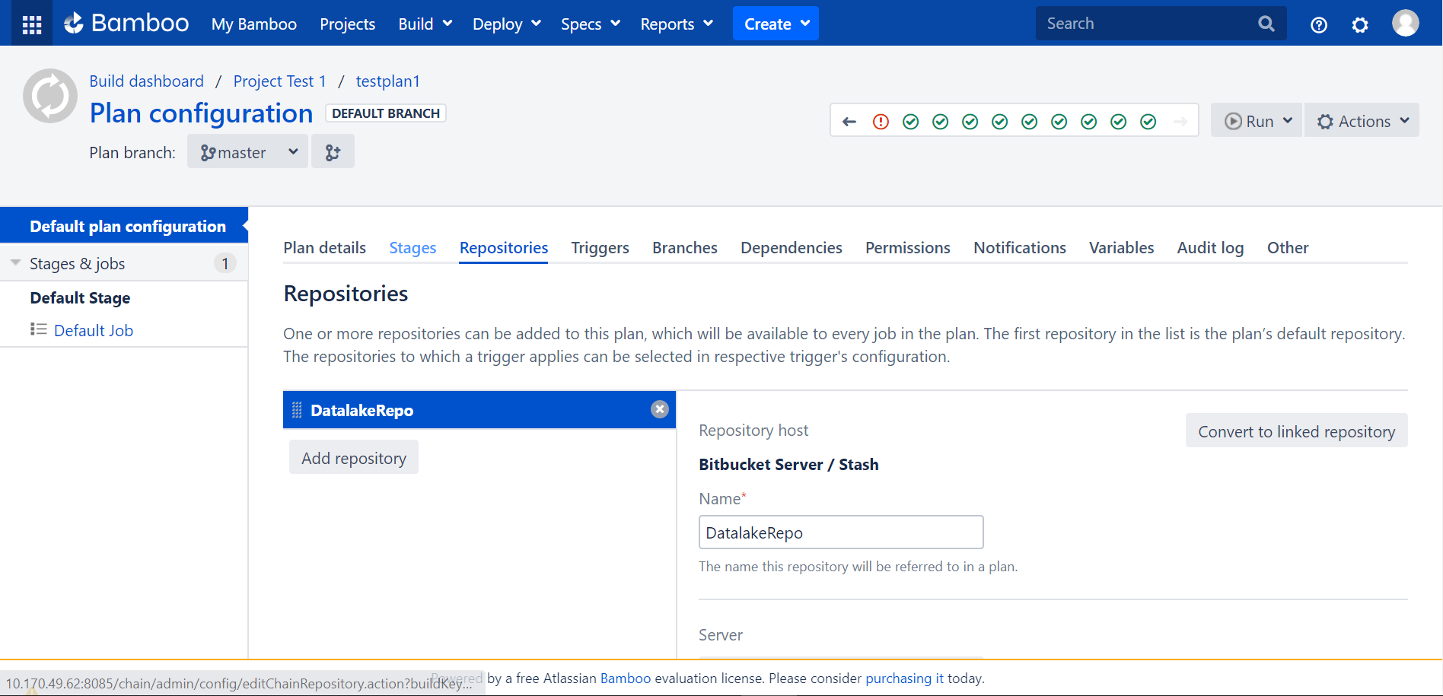
Bamboo Linked Repository
c

Slide 10
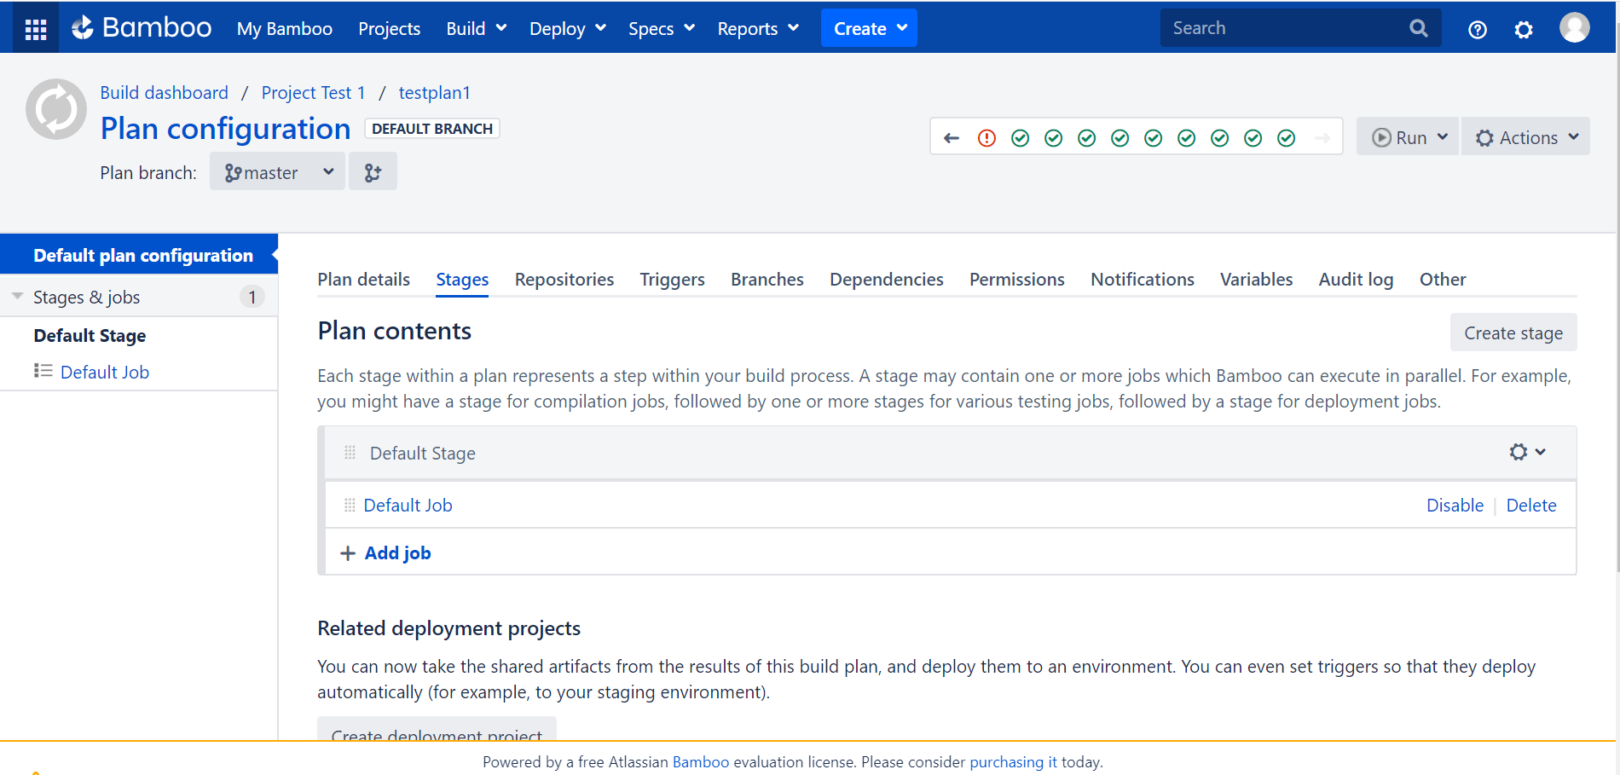
Bamboo Job

Slide 11
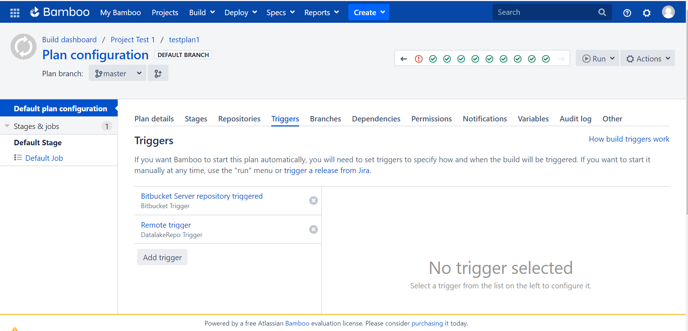
Bamboo Build Triggers

Slide 12
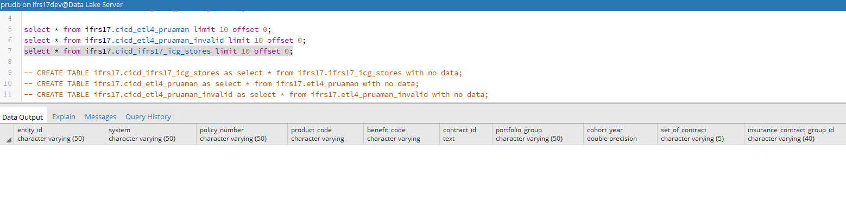
Placeholder Table Before Build (1)

Slide 13
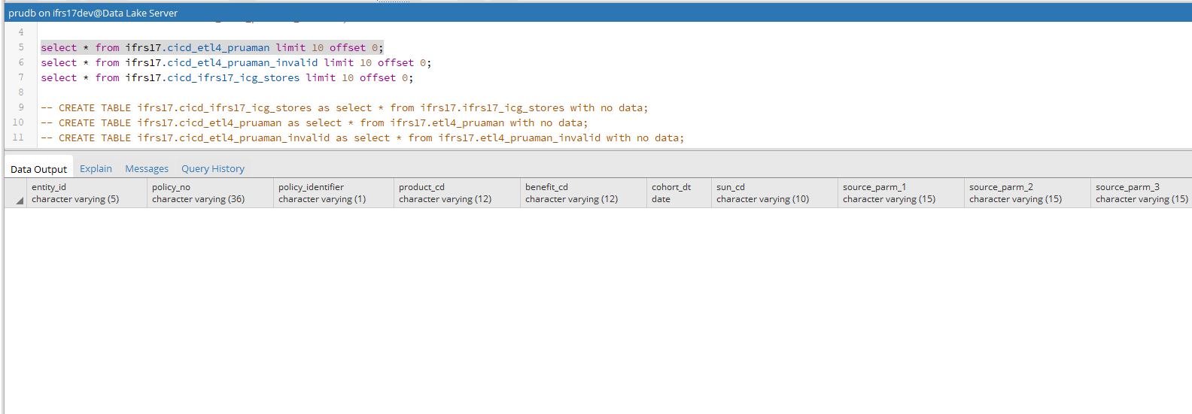
Placeholder Table Before Build (2)

Slide 14
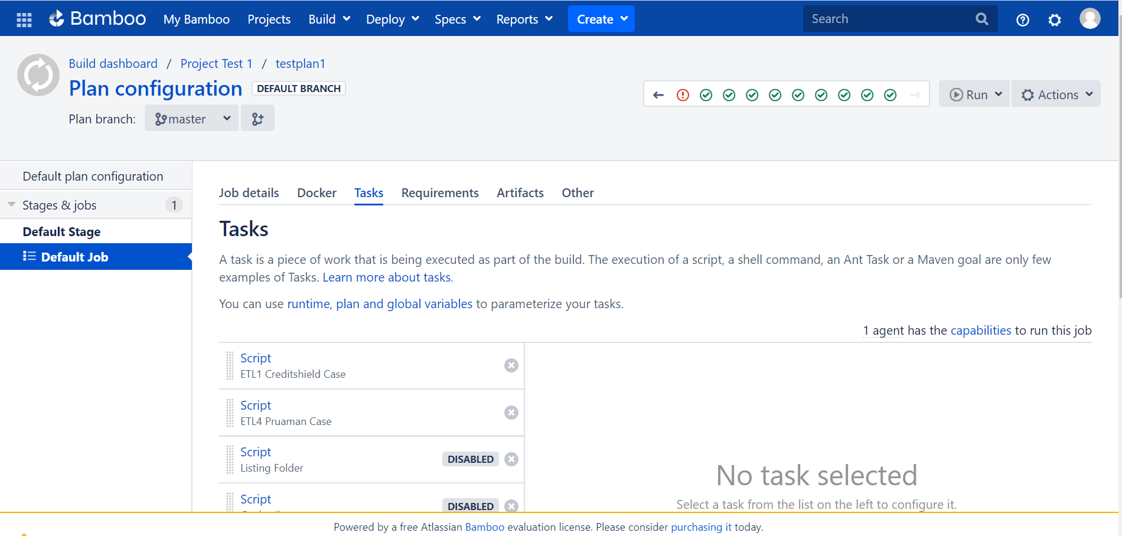
Bamboo Tasks

Slide 15
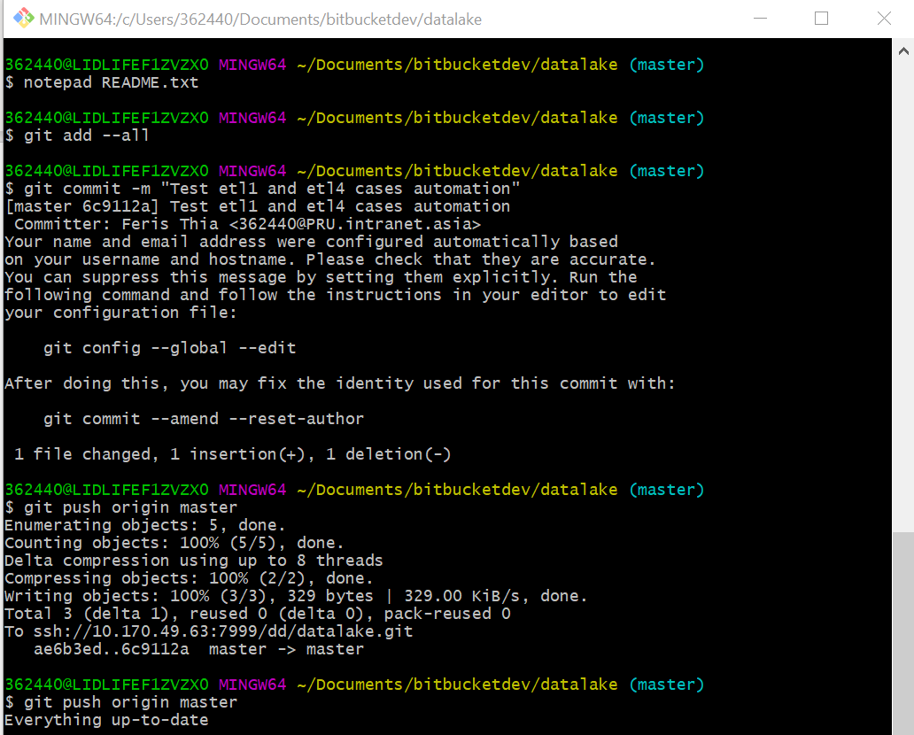
Git Push

Slide 16
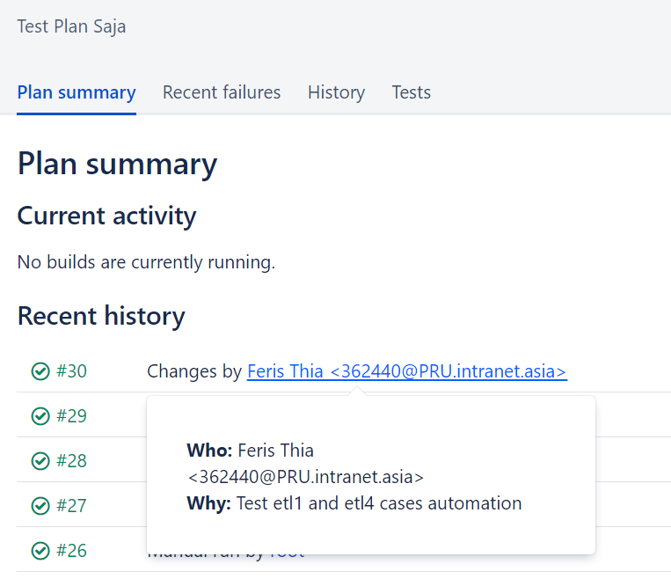
Build Triggered and Succeed

Slide 17
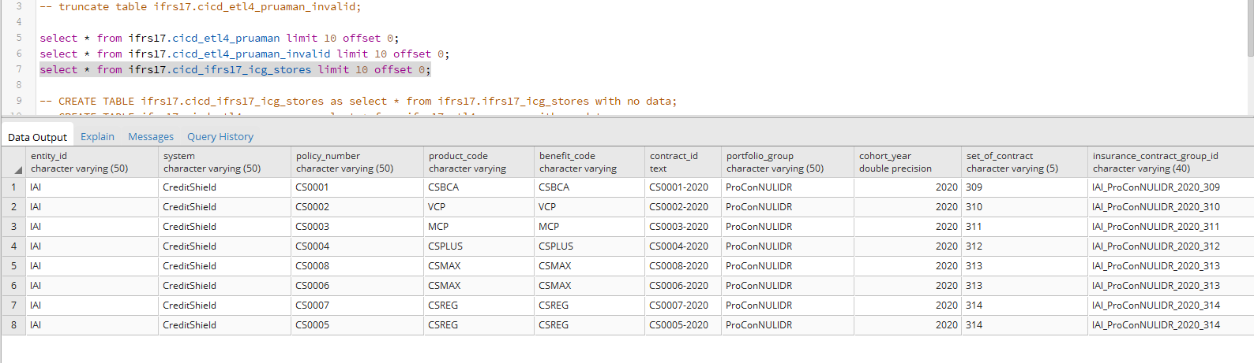
Result (1)

Slide 18
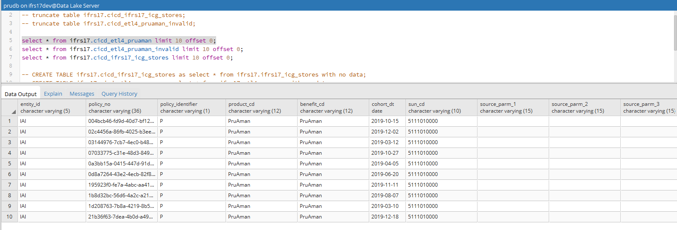
Result (2)

Slide 19
Thank you

